Slide 1
Prospective Secondary Mathematics Teachers’ Gender-wise Attitudes on Using a Web 2.0 Technology in Teaching-Learning Euclidean Geometry
(Paper 3 of 3)
Dr. Mokter Hossain
University of Alabama &
University of Nevada, Reno
&
Dr. Robert Quinn
University of Nevada, Reno
24th SITE International Conference-2013
New Orleans, LA, USA, March 25-29, 2013

Slide 2
Prospective Secondary Mathematics Teachers’ Gender-wise Attitudes on Using a Web 2.0 Technology in Teaching-Learning Euclidean Geometry
OVERVIEW
The Organization of this Presentation
INTRODUCTION
OBJECTIVE OF THE STUDY
RESEARCH QUESTION
PROCEDURE OF THE STUDY
PARTICIPANTS AND DATA
FINDINGS
IMPLICATIONS OF THE STUDY
CONCLUSION

Slide 3
Prospective Secondary Mathematics Teachers’ Gender-wise Attitudes on Using a Web 2.0 Technology in Teaching-Learning Euclidean Geometry
Introduction
Technology use is emphasized in the NCTM (2000) Principles and Standards for School Mathematics, in the United States
However, use of technology is not available and effective at all levels; especially in teacher education programs
Increasing demand of mathematics teaching-learning software and web-based programs
High cost/annual license fee; and high configuration computers
Young students’ trends on social networking sites
Expectation of free, anywhere, anytime and easy to use programs

Slide 4
Prospective Secondary Mathematics Teachers’ Gender-wise Attitudes on Using a Web 2.0 Technology in Teaching-Learning Euclidean Geometry
Introduction…
Web 2.0 is a collaborative Web development platform
Web 2.0 technology has a great potential to meet these demands
Web 2.0 technologies have many Interactive Features
Most of the Web 2.0 applications are free of very low cost
Expectation of free, anywhere, anytime and easy to use programs
Users can add, control, and share information interactively and simultaneously on the Web, mostly for free
Creating and editing most Web 2.0 applications is free, fast, and requires only basic computing knowledge

Slide 5
Prospective Secondary Mathematics Teachers’ Gender-wise Attitudes on Using a Web 2.0 Technology in Teaching-Learning Euclidean Geometry
Objective and Significance of the Study
Investigating Relationships between Attitudes toward the use of Web 2.0 Technologies and Mathematical Achievement
As a standard example of Web 2.0 application, Blog was Selected as a supportive Teaching-Learning Tool
Use of a Blog might be a new dimension of using technology
Most of the Participants were Preservice Mathematics Teachers
Results may be useful for Math Students, Teachers, & Educators

Slide 6
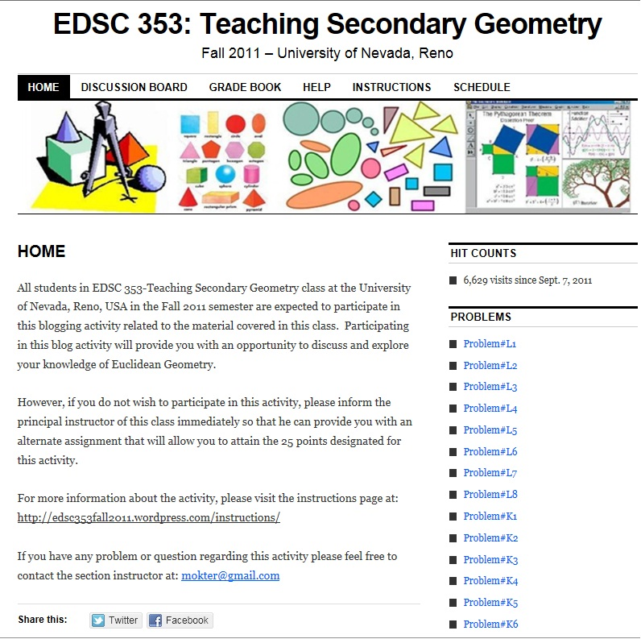
Prospective Secondary Mathematics Teachers’ Gender-wise Attitudes on Using a Web 2.0 Technology in Teaching-Learning Euclidean Geometry
Procedure
of the Study

Slide 7
Prospective Secondary Mathematics Teachers’ Gender-wise Attitudes on Using a Web 2.0 Technology in Teaching-Learning Euclidean Geometry
METHODOLOGY
Research Question:
  Are there any significant difference by gender with regard to preservice mathematics teachers’ attitudes toward the blogging activity in a college Euclidean Geometry course?
Working Definitions:
Independent Variables:
(1) Participants’ gender –two categories: male and female;
Dependent Variables:
Participants’ attitudes scores – measured by calculating the median response to the 16 Likert-type items on a six-point scale;

Slide 8
Prospective Secondary Mathematics Teachers’ Gender-wise Attitudes on Using a Web 2.0 Technology in Teaching-Learning Euclidean Geometry
Participants’ Demographic Information
Table: Descriptive Statistics of Participants’ Age
 |  |  | Age
N | Male | 12
 | Female | 16
 | Total | 28
Mean |  |  | 26.43
Median |  |  | 22.00
Mode |  |  | 20ª
Std. Deviation |  |  | 10.149
Range |  |  | 41
a. Multiple modes exist. The smallest value is shown

Slide 9
Prospective Secondary Mathematics Teachers’ Gender-wise Attitudes on Using a Web 2.0 Technology in Teaching-Learning Euclidean Geometry
Overall Attitudes Scores
Table : Frequency Statistics of Median Attitude Scores
 | Median Attitude Scores
Valid N | 28
Missing N | 0
Mean | 4.1786
Std. Error of Mean | .18041
Median | 4.0000
Mode | 4.00
Std. Deviation | .95466
Implies that participants were more than positively Agree in their attitudes toward using the blog

Slide 10
Prospective Secondary Mathematics Teachers’ Gender-wise Attitudes on Using a Web 2.0 Technology in Teaching-Learning Euclidean Geometry
Result: There were no significant difference by gender with regard to preservice mathematics teachers’ attitudes toward the blogging activity in a college Euclidean Geometry course
Table: Wilcoxon-Mann-Whitney U Test Statistics for Attitude Scores on Participants’ Gender
 | Median Attitudes
Mann-Whitney U | 68.000
Wilcoxon W | 204.000
Z | -1.377
Asymp. Sig. (2-tailed) | .169
Exact Sig. [2*(1-tailed Sig.)] | .205ª
a. Not corrected for ties.
(N = 28, U = 68.0, p = .169 > .05); Non-Significant

Slide 11
Prospective Secondary Mathematics Teachers’ Gender-wise Attitudes on Using a Web 2.0 Technology in Teaching-Learning Euclidean Geometry
Implications for Practice
No unfair advantages to male or female participants
Preservice teachers found it positive and effective
New teaching-learning tool – could be included in the schools, and teacher education curricula
Can develop collaborative teaching-learning environment
A free and public forum for online discussion

Slide 12
Prospective Secondary Mathematics Teachers’ Gender-wise Attitudes on Using a Web 2.0 Technology in Teaching-Learning Euclidean Geometry
Limitations and Delimitations
The study dealt with a single class of 28 students
The study has only about 51% chance of finding a significant mean difference between the groups, if it really existed
Euclidean Geometry problems that required participants using construction tools or uploading of images and graphs were avoided
Participants were asked to type mathematical formulas in plain text format
Did not use a control/experimental group
Did not measure the instructor’s perceptions

Slide 13
Prospective Secondary Mathematics Teachers’ Gender-wise Attitudes on Using a Web 2.0 Technology in Teaching-Learning Euclidean Geometry
Recommendations for Further Research
Replication of this study in another college Euclidean Geometry Course
Replication of this study in a online college Euclidean Geometry Course
Replication of this study in a high school Euclidean Geometry Course
Conduct the quantitative and qualitative components in different ways
Improve the instruments used in the present study.

Slide 14
Prospective Secondary Mathematics Teachers’ Gender-wise Attitudes on Using a Web 2.0 Technology in Teaching-Learning Euclidean Geometry
Conclusions
Use of a blog in a College Euclidean Geometry Course is enjoyable and effective
No significant difference in the measures of attitude on Gender
Collaborative, motivational; anytime, anywhere, easy accessible
Participants found blog as an open and public forum
Numerous potential to improve teaching-learning mathematics

Slide 15

Prospective Secondary Mathematics Teachers’ Gender-wise Attitudes on Using a Web 2.0 Technology in Teaching-Learning Euclidean Geometry
QUESTIONS & ANSWERS??
Please Discuss Online;
Or, Email at: mokter@gmail.com
Thank You

